Slide 1
Elastic Load Balancing
Scalability and High Availability
What is Elastic Load Balancing
Load Balancer Benefits
ELB Listener
Classic Load Balancer

Slide 2
Scalability and High Availability
Scalability is a process to handle a growing amount of work load by adding resources to the system. There are two kinds of scalability:
Vertical Scaling
Horizontal Scaling(= elasticity)
Vertical Scaling
Vertical scaling refers to adding more resources (CPU/RAM/DISK) to your server
For example, your application runs on a t2.micro. Scaling that application vertically means changing it on a t2.large.
RDS, ElastiCache are services that can scale vertically

Slide 3
Horizontal Scalability.
Horizontal scaling, commonly referred to as scale-out, is the capability to automatically add systems/instances in a distributed manner in order to handle an increase in load
The High Availability
The High Availability (HA) describes a system that is operating continuously without any failure.
High availability means running your application in at least 2 data centers
The goal of high availability is to survive a data center loss

Slide 4
AWS Elastic Load Balancing
Elastic Load Balancing distributes your incoming traffic across multiple targets, such as EC2 instances, containers, and IP addresses, in one or more Availability Zones
It monitors the health of its registered targets, and routes traffic only to the healthy targets.
Elastic Load Balancing supports the following load balancers:
Classic Load Balancers
Application Load Balancers
Network Load Balancers
Gateway Load Balancers.

Slide 5
Load Balancer Benefits
A load balancer distributes workloads across multiple compute resources, such as virtual servers.
Increases the availability and fault tolerance of your applications.
You can add and remove compute resources from your load balancer as your needs change, without disrupting the overall flow of requests to your applications.
You can configure health checks, which monitor the health of the compute resources
Enforce stickiness with cookies
High availability across zones
Separate public traffic from private traffic

Slide 6
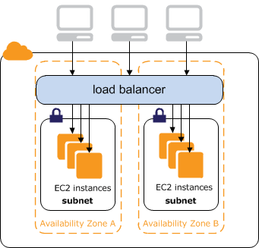

Slide 7
ELB Listener
A listener is a process that checks for connection requests.
It is configured with a protocol and a port for front-end connections, and a protocol and a port for back-end connections.
Elastic Load Balancing supports the following protocols:
HTTP
HTTPS (secure HTTP)
TCP
SSL (secure TCP)
HTTPS protocol uses the SSL protocol to establish secure connections over the HTTP layer.
SSL protocol to establish secure connections over the TCP layer.

Slide 8
Classic Load Balancer
A load balancer distributes incoming application traffic across multiple EC2 instances in multiple Availability Zones.
Load balancer serves as a single point of contact for clients.
Increases the fault tolerance of your applications.
Increases the availability of your application
Elastic Load Balancing detects unhealthy instances and routes traffic only to healthy instances.
You can add and remove instances from your load balancer as your needs change, without disrupting the overall flow of requests to your application.

Slide 9
Classic Load Balancer
Elastic Load Balancing scales your load balancer as traffic to your application changes over time. Elastic Load Balancing can scale to the vast majority of workloads automatically.
A listener checks for connection requests from clients, using the protocol and port that you configure, and forwards requests to one or more registered instances using the protocol and port number that you configure.
You can configure health checks, which are used to monitor the health of the registered instances so that the load balancer only sends requests to the healthy instances.
By default, the load balancer distributes traffic evenly across the Availability Zones. Enable cross-zone load balancing to distribute traffic evenly across all registered instances.

Slide 10
Classic Load Balancer Types
Internet Facing Load Balancer
An internet-facing load balancer has a publicly resolvable DNS name
It can route requests from clients over the internet to the private IP addresses of EC2 instances that are registered with the load balancer.
You need one “Public” subnet in each AZ where the internet facing ELB will be defined.

Slide 11
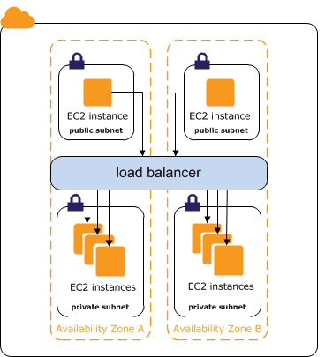
Classic Load Balancer Types
Internal Load Balancer
The nodes of an internal load balancer have only private IP addresses.
The DNS name of an internal load balancer is publicly resolvable to the private IP addresses of the nodes.
Internal load balancers can only route requests from clients with access to the VPC for the load balancer.

Slide 12
Internal Load Balancer UsageCase
If your application has multiple tiers, for example web servers that must be connected to the internet and application servers, you can design an architecture that uses both internal and internet-facing load balancers.
Create an internet-facing load balancer and register the web servers with it.
Create an internal load balancer and register the application servers with it.
The web servers receive requests from the internet-facing load balancer and send requests for the application servers to the internal load balancer.
The application servers receive requests from the internal load balancer.

Slide 13
Listener Configurations
https://docs.aws.amazon.com/elasticloadbalancing/latest/classic/using-elb-listenerconfig-quickref.html
Protocol and port supported:
HTTP
HTTPS
TCP
SSL

Slide 14
Assign Security Groups
In a VPC, you must ensure that the security groups for your instances allow the load balancer to communicate with your instances on both the listener port and the health check port.
In a VPC, your security groups and network access control lists (ACL) must allow traffic in both directions on these ports.
The security group must allow traffic in both directions to the listener and health check ports for the load balancer.

Slide 15
Configure Health Check
The load balancer monitors the health of its registered instances and ensures that it routes traffic only to healthy instances
A healthy instance shows as “In-Service” under the ELB
When the ELB detects an unhealthy instance, it stops routing traffic to that instance. An un-healthy instance shows as “Out-of-Service” under the ELB
When the ELB service detects the EC2 instance is back healthy, it resumes traffic routing to the Instance again
The default values of health check
Ping Protocol: HTTP
Ping Port: 80
Ping Path: /index.html

Slide 16
Health Check
You can add any custom value and configure the health check
More details
Response Timeout: 5 seconds
Interval: 30 seconds
Unhealthy threshold: 2
Healthy threshold: 10
Registered instances must respond with a HTTP “200 OK” message within the timeout period, else, it will be considered as unhealthy
Number of consecutive failed health checks that should occur before the instance is declared unhealthy
Number of consecutive successful health checks that must occur before the instance is considered healthy

Slide 17
Cross Zone Load Balancing
The CLB will distribute traffic evenly between registered EC2 instances in the different AZ’s.
This is to ensure that each registered/healthy instance gets an equal share of traffic from the CLB
If you have 8 EC2 instances in one AZ, and 2 in another, cross-zone load balancing will ensure that each registered EC2 instance will be getting around the same amount of traffic load from the ELB

Slide 18
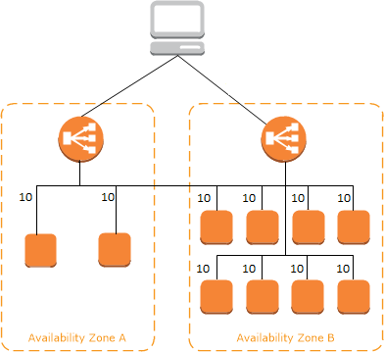
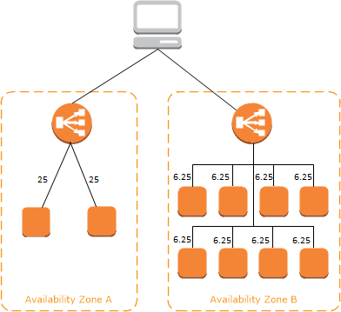
cross-zone load balancing is enabled
cross-zone load balancing is disabled

Slide 19
Routing Algorithm
Uses the round robin routing algorithm for TCP listeners
Uses the least outstanding requests routing algorithm for HTTP and HTTPS listeners
Supports HTTP headers
X-Forwarded-For
X-Forwarded-Proto
X-Forwarded-Port

Slide 20
Configure Sticky Sessions
Classic Load Balancer routes each request independently to the registered instance with the smallest load.
You can use the sticky session feature (also known as session affinity), which enables the load balancer to bind a user's session to a specific instance.
This ensures that all requests from the user during the session are sent to the same instance.

Slide 21
Connection Draining
To ensure that a Classic Load Balancer stops sending requests to instances that are de-registering or unhealthy, while keeping the existing connections open, use connection draining.
This enables the load balancer to complete in-flight requests made to instances that are de-registering or unhealthy.
When you enable connection draining, you can specify a maximum time for the load balancer to keep connections alive before reporting the instance as de-registered.
Timeout range 1 ~ 3,600 seconds (default: 300)
When the maximum time limit is reached, the load balancer forcibly closes connections.
During the connection draining, the Back end instance state will be “InService : Instance Deregistration Currently In Progress”
AWS Auto-Scaling would also honor the connection draining setting for unhealthy instances
During the connection draining period, ELB will not send new requests to the unhealthy Instance

Slide 22
Idle Connection Timeout
For each request, load balancer maintains two connections.
Front-end connection is between the client and the load balancer.
Back-end connection is between the load balancer and a registered EC2 instance.
The load balancer has a configured idle timeout period that applies to its connections.
If no data has been sent or received by the time that the idle timeout period elapses, the load balancer closes the connection.
Idle timeout range 1 ~ 4,000 seconds.
Default 60 seconds

Slide 23
Monitoring Load Balancer
CloudWatch Metrics
Elastic Load Balancing publishes data points to Amazon CloudWatch for your load balancers and your back-end instances.
AWS Cloud Watch can be used to trigger an SNS notification if a threshold you define is reached
Elastic Load Balancing Access Logs
Disabled by default
You can obtain request information such as requester, time a request was received, the client's IP address, latencies, request path, and server responses
You can choose to store the access logs in an S3 bucket that you specify
CloudTrail logs
You can use it to capture all API calls for your ELB
You can store these logs in an S3 bucket that you specify

Slide 24
Quotas for your Classic Load Balancer
Load balancers per Region: 20
Listeners per load balancer: 100
Security groups per load balancer: 5
Registered instances per load balancer: 1,000
Subnets per Availability Zone per load balancer: 1

Slide 25
Application Load Balancer
Automatically distributes your incoming traffic across multiple targets, such as EC2 instances, Containers, Lambda Functions, and IP addresses, in one or more Availability Zones.
It monitors the health of its registered targets, and routes traffic only to the healthy targets.
Scales your load balancer as your incoming traffic changes over time. It can automatically scale to the vast majority of workloads.
Cross zone load balancing is enabled by default
Supports enhanced health checks and enhanced CloudWatch metrics
ALB provides additional information in Access Logs compared to CLB
Internet facing ALB supports IPv4 and DualStack
Internal ALB uses IPv4 only (no dual stack support yet)

Slide 26
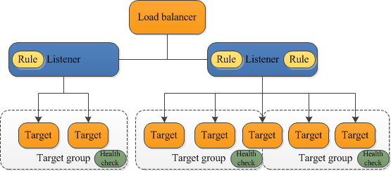

Slide 27
Application Load Balancer Components
Listeners
Target Groups
Targets
Rules (Condition, Action, Priority)

Slide 28
ALB Listeners
A listener is a process that checks for connection requests, using the configured protocol and port.
The rules that you define for a listener determine how the load balancer routes requests to its registered targets.
Protocols: HTTP, HTTPS
Ports: 1-65535
WebSockets protocol support
Application Load Balancers provide native support for Websockets.
Websockets allow for full duplex communication
Both HTTP and HTTPS listeners.
Enabled by default
HTTP/2 Support
Allow multiple requests at the same time

Slide 29
ALB Listener Rules
Each listener has a default rule
You can optionally define additional rules.
Each rule consists of a
Priority,
One or more actions
One or more conditions
Rules are evaluated in priority order, from the lowest value to the highest value.
When the condition is met, the traffic is forwarded to the target group
The default rule is evaluated last.
You can delete the non-default rules for a listener at any time.
You cannot delete the default rule for a listener

Slide 30
ALB Target Groups
Target Group is used to route requests to one or more registered targets.
When listener rule created, a target group and conditions is specified.
When a rule condition is met, traffic is forwarded to the corresponding target group.
You can create different target groups for different types of requests.
Health check settings provided per target group basis.
The load balancer continually monitors the health of all targets registered with the target group
The ALB, routes requests to its targets using the protocol and port number that is specified in the target group

Slide 31
ALB Target Groups
Target type
Instance - The targets are specified by instance ID.
IP - The targets are IP addresses.
Lambda - The target is a Lambda function
Protocols
HTTP
HTTPS
Ports
1 ~ 65535

Slide 32
ALB Routing
Routing tables to different target groups:
Routing based on path in URL
Ex: abc.com/users, abc.com/groups/main
Routing based on hostname in URL
app.abc.com, web.abc.com)
Routing based on Query String
Ex: Headers abc.com/users?id=ID0089

Slide 33
ALB - Monitoring
CloudWatch Metrics
Published every 1 minute if there are requests flowing through the ALB
Access logs
You can use access logs to capture detailed information about the requests made to your load balancer and store them as log files in Amazon S3.
You can use these access logs to analyze traffic patterns and to troubleshoot issues with your targets.
CloudTrail logs
You can use AWS CloudTrail to capture detailed information about the calls made to the ELB API and store them as log files in Amazon S3.
You can use these CloudTrail logs to determine which calls were made, the source IP address where the call came from, who made the call, when the call was made, and so on.

Slide 34
Network Load Balancer
A Network Load Balancer functions at the 4th layer (Network Layer) of the Open Systems Interconnection (OSI) model.
It can handle millions of requests per second. Faster than ALB
After the load balancer receives a connection request, it selects a target from the target group for the default rule.
It attempts to open a TCP connection to the selected target on the port specified in the listener configuration.
Elastic Load Balancing creates a network interface for each Availability Zone you enable.
Each load balancer node in the Availability Zone uses this network interface to get a static IP address.
When you create an Internet-facing load balancer, you can optionally associate one Elastic IP address per subnet.

Slide 35
Benefits of NLB over CLB
Ability to handle volatile workloads and scale to millions of requests per second.
Support for static IP addresses for the load balancer. You can also assign one Elastic IP address per subnet enabled for the load balancer.
Support for registering targets by IP address, including targets outside the VPC for the load balancer.
Support for routing requests to multiple applications on a single EC2 instance. You can register each instance or IP address with the same target group using multiple ports.
Support for containerized applications.
Support for monitoring the health of each service independently

Slide 36
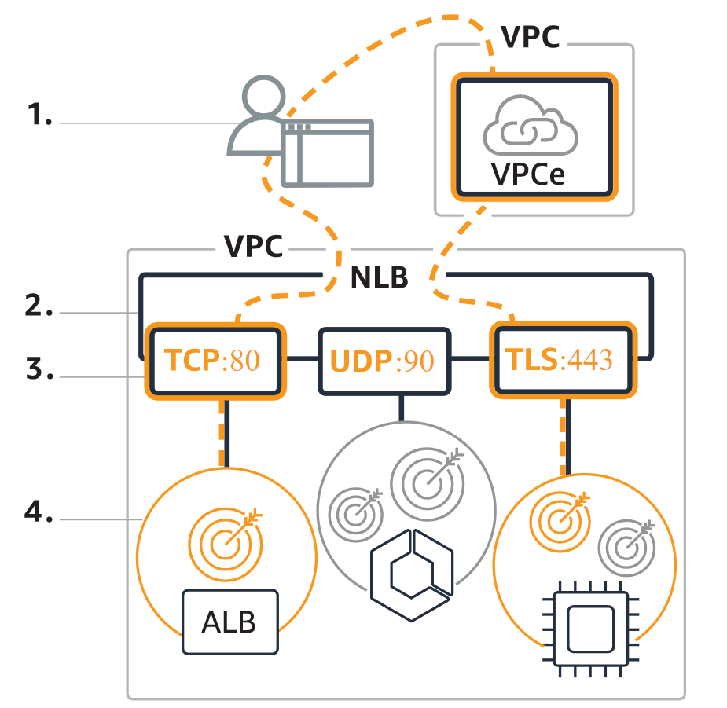
How NLB Works
Your client makes a request to your application.
The load balancer receives the request either directly or through an endpoint for private connectivity
The listeners in your load balancer receive requests of matching protocol and port, and route these requests based on the default action that you specify. You can use a TLS listener to offload the work of encryption and decryption to your load balancer.
Healthy targets in one or more target groups receive traffic according to the flow hash algorithm.

Slide 37
Monitoring Network Load Balancers
CloudWatch metrics
Amazon CloudWatch is used to retrieve statistics about data points for your load balancers and targets metrics.
VPC Flow Logs
VPC Flow Logs can be used to capture detailed information about the traffic going to and from your Network Load Balancer.
Create a flow log for each network interface for your load balancer. There is one network interface per load balancer subnet.
Access logs
You can use access logs to capture detailed information about TLS requests made to your load balancer. The log files are stored in Amazon S3.
CloudTrail logs
AWS CloudTrail can be used to capture detailed information about the calls made to the Elastic Load Balancing API and store them as log files in Amazon S3.
You can use these CloudTrail logs to determine which calls were made, the source IP address where the call came from, who made the call, when the call was made, and so on.

